Slide 1
Random Forest
1

Slide 2
Random Forest Classifier
Why a forest?
Why Random?
2

Slide 3
Decision Tree vs Random Forest
Decision Trees are easy to build, easy to use and easy to interpret
But its not that aewsome
Inaccuracy
DT work great with data used to create them, but they are not flexible when it comes to classifying new samples
The good news is that Random Forests combine the simplicity of DTs with flexibility resulting in a vast improvement in accuracy

Slide 4
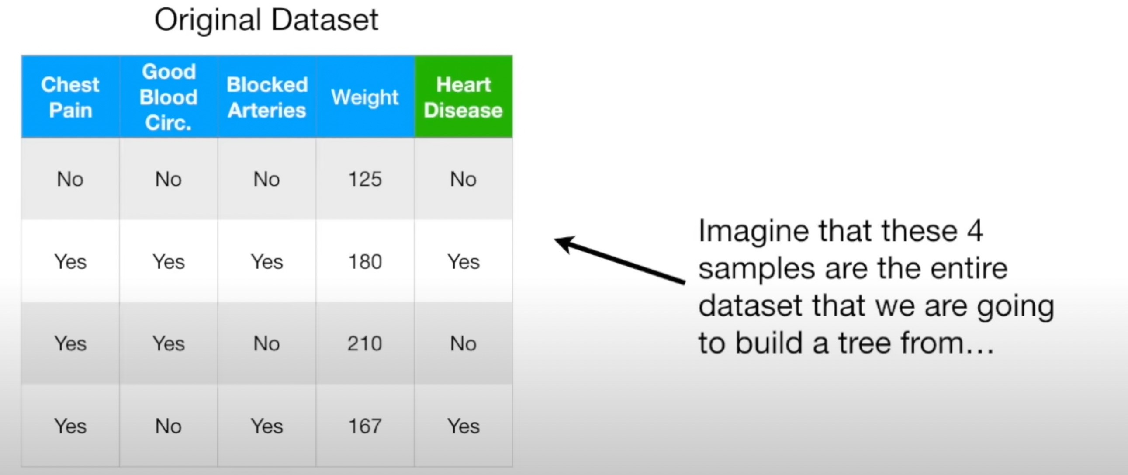

Slide 5
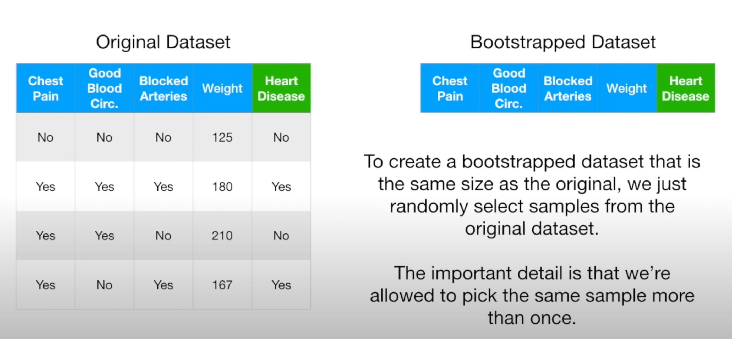

Slide 6
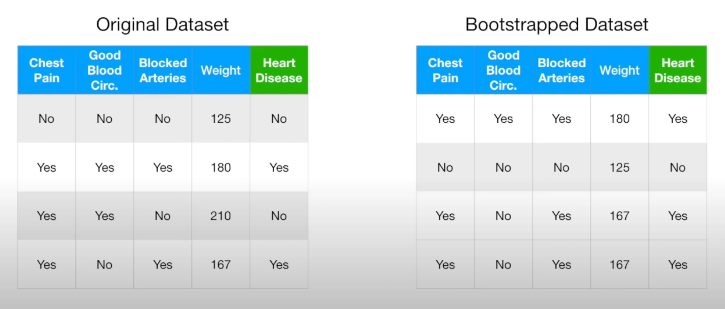

Slide 7
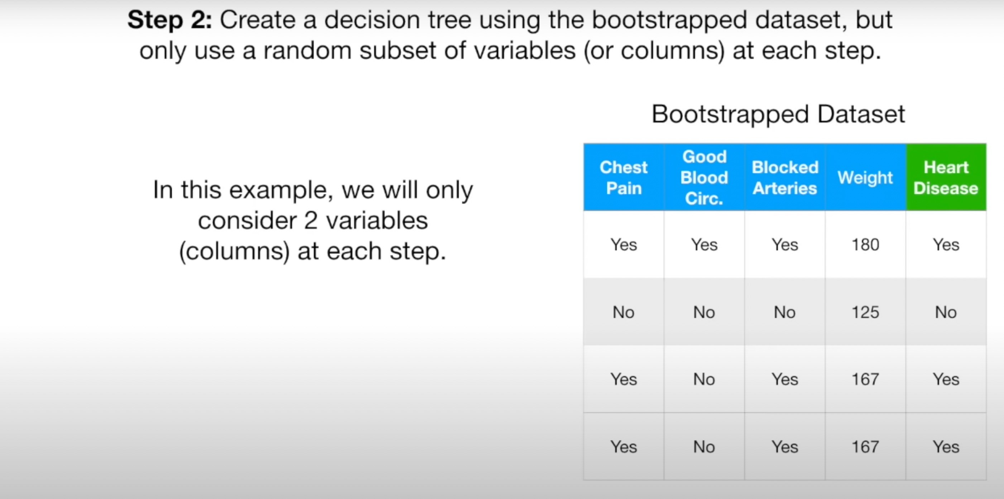

Slide 8
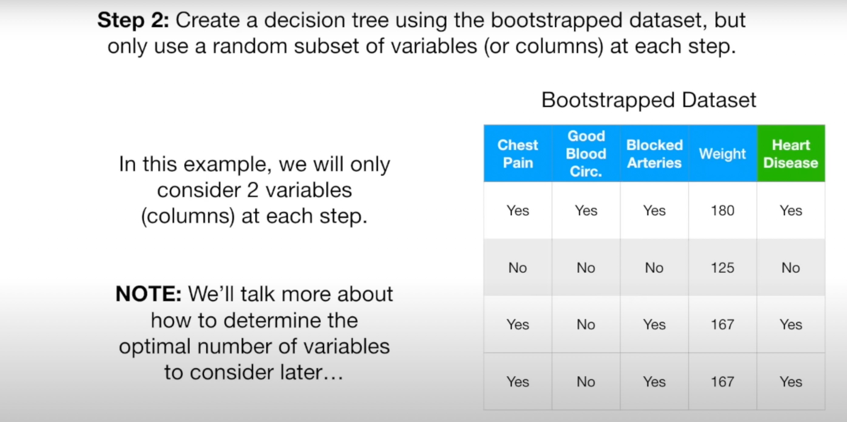

Slide 9
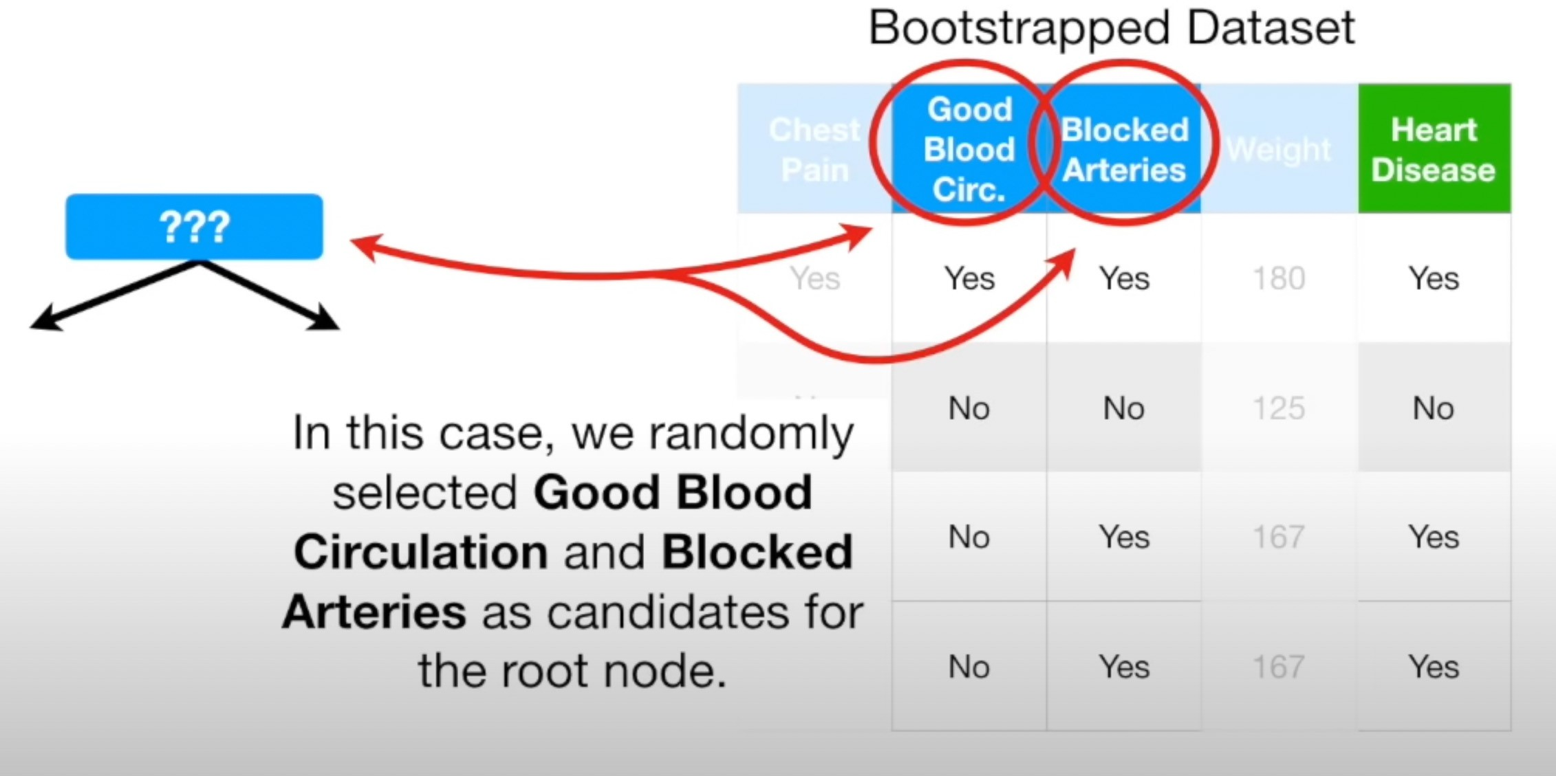

Slide 10
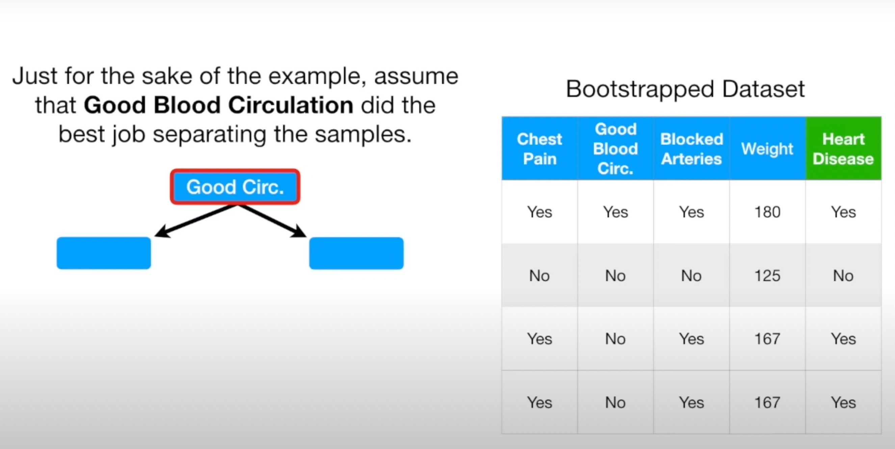

Slide 11
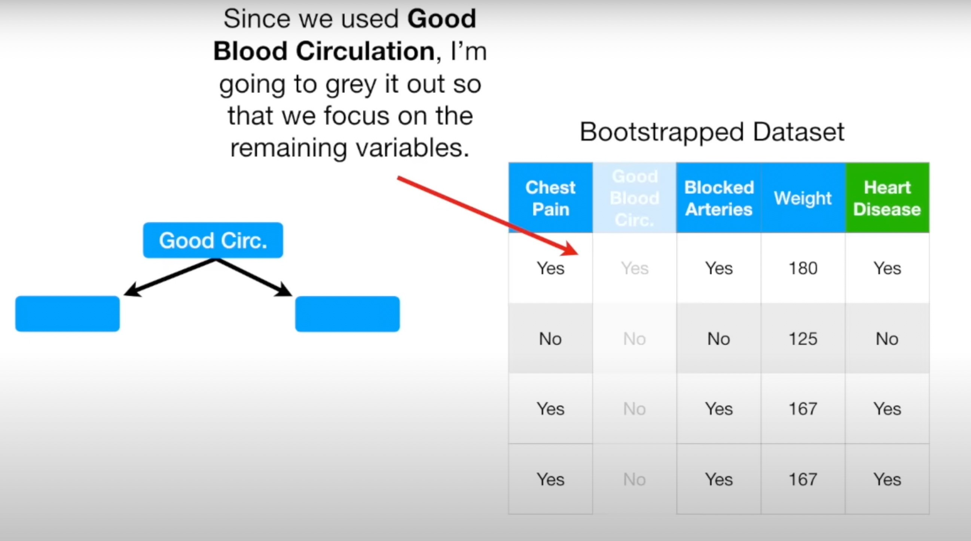

Slide 12
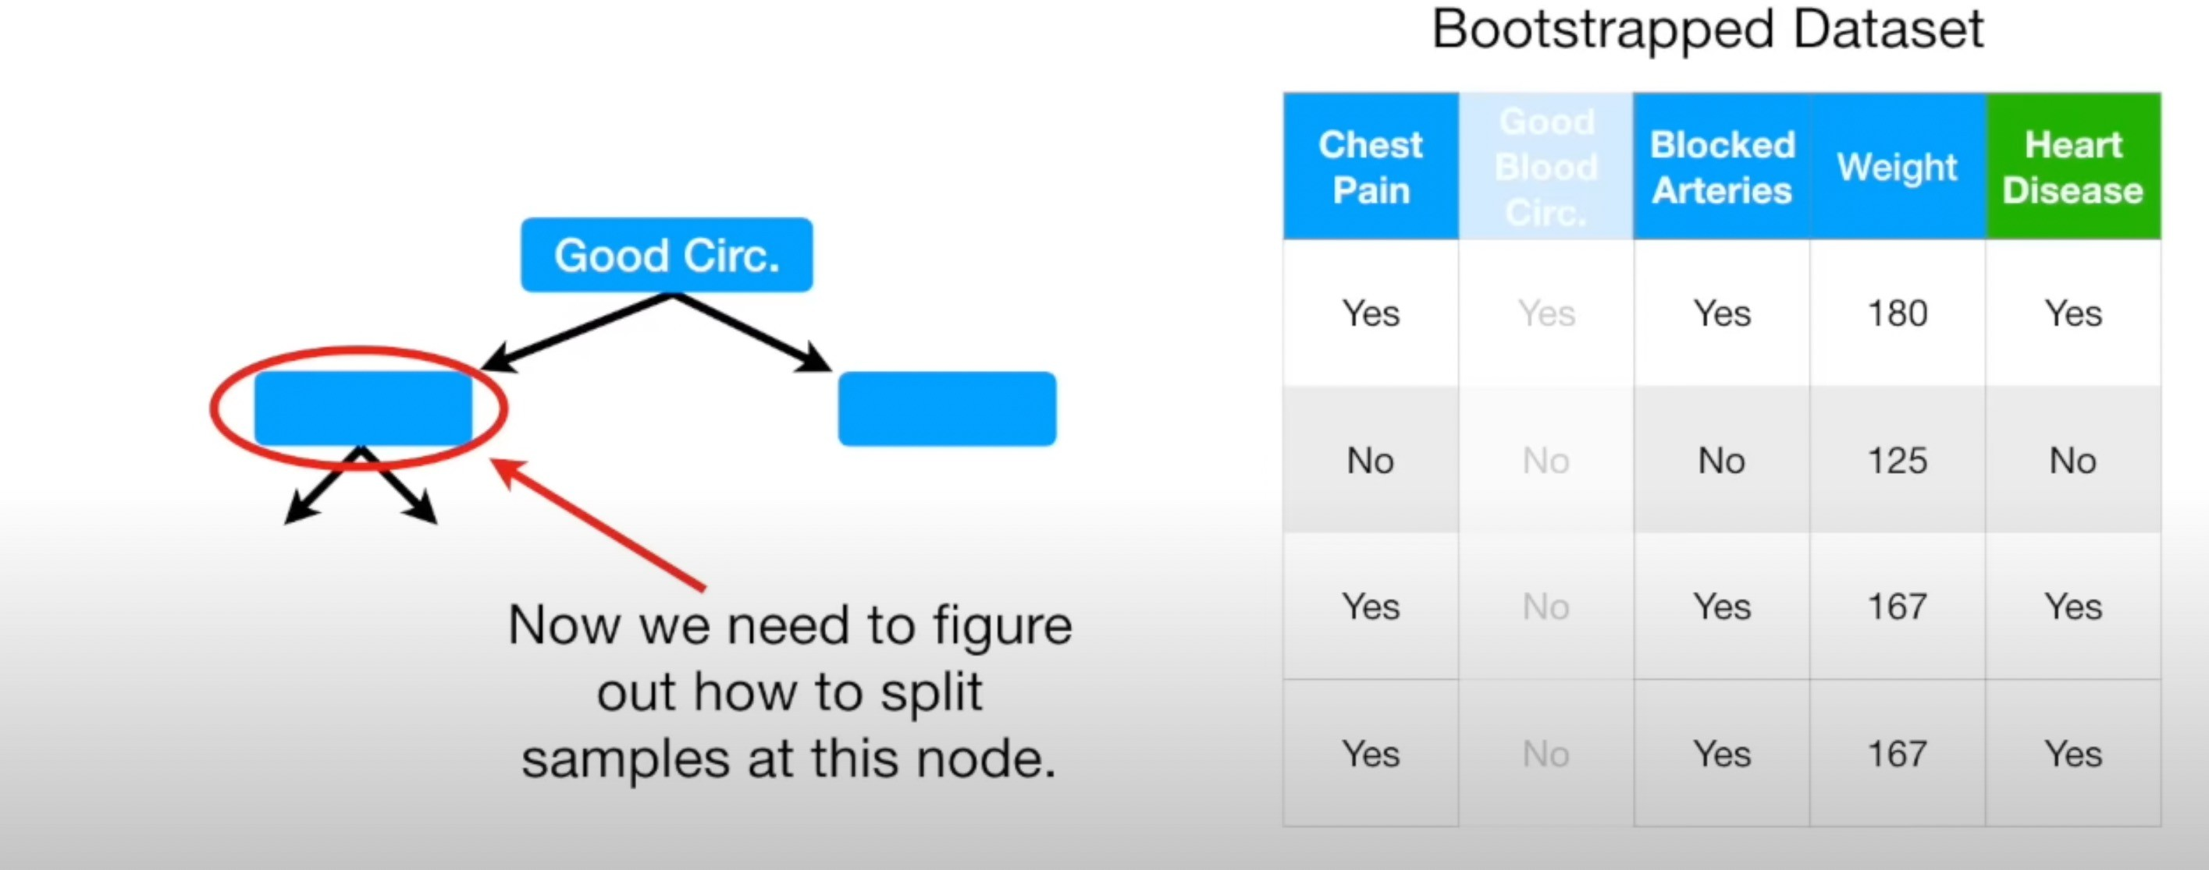

Slide 13
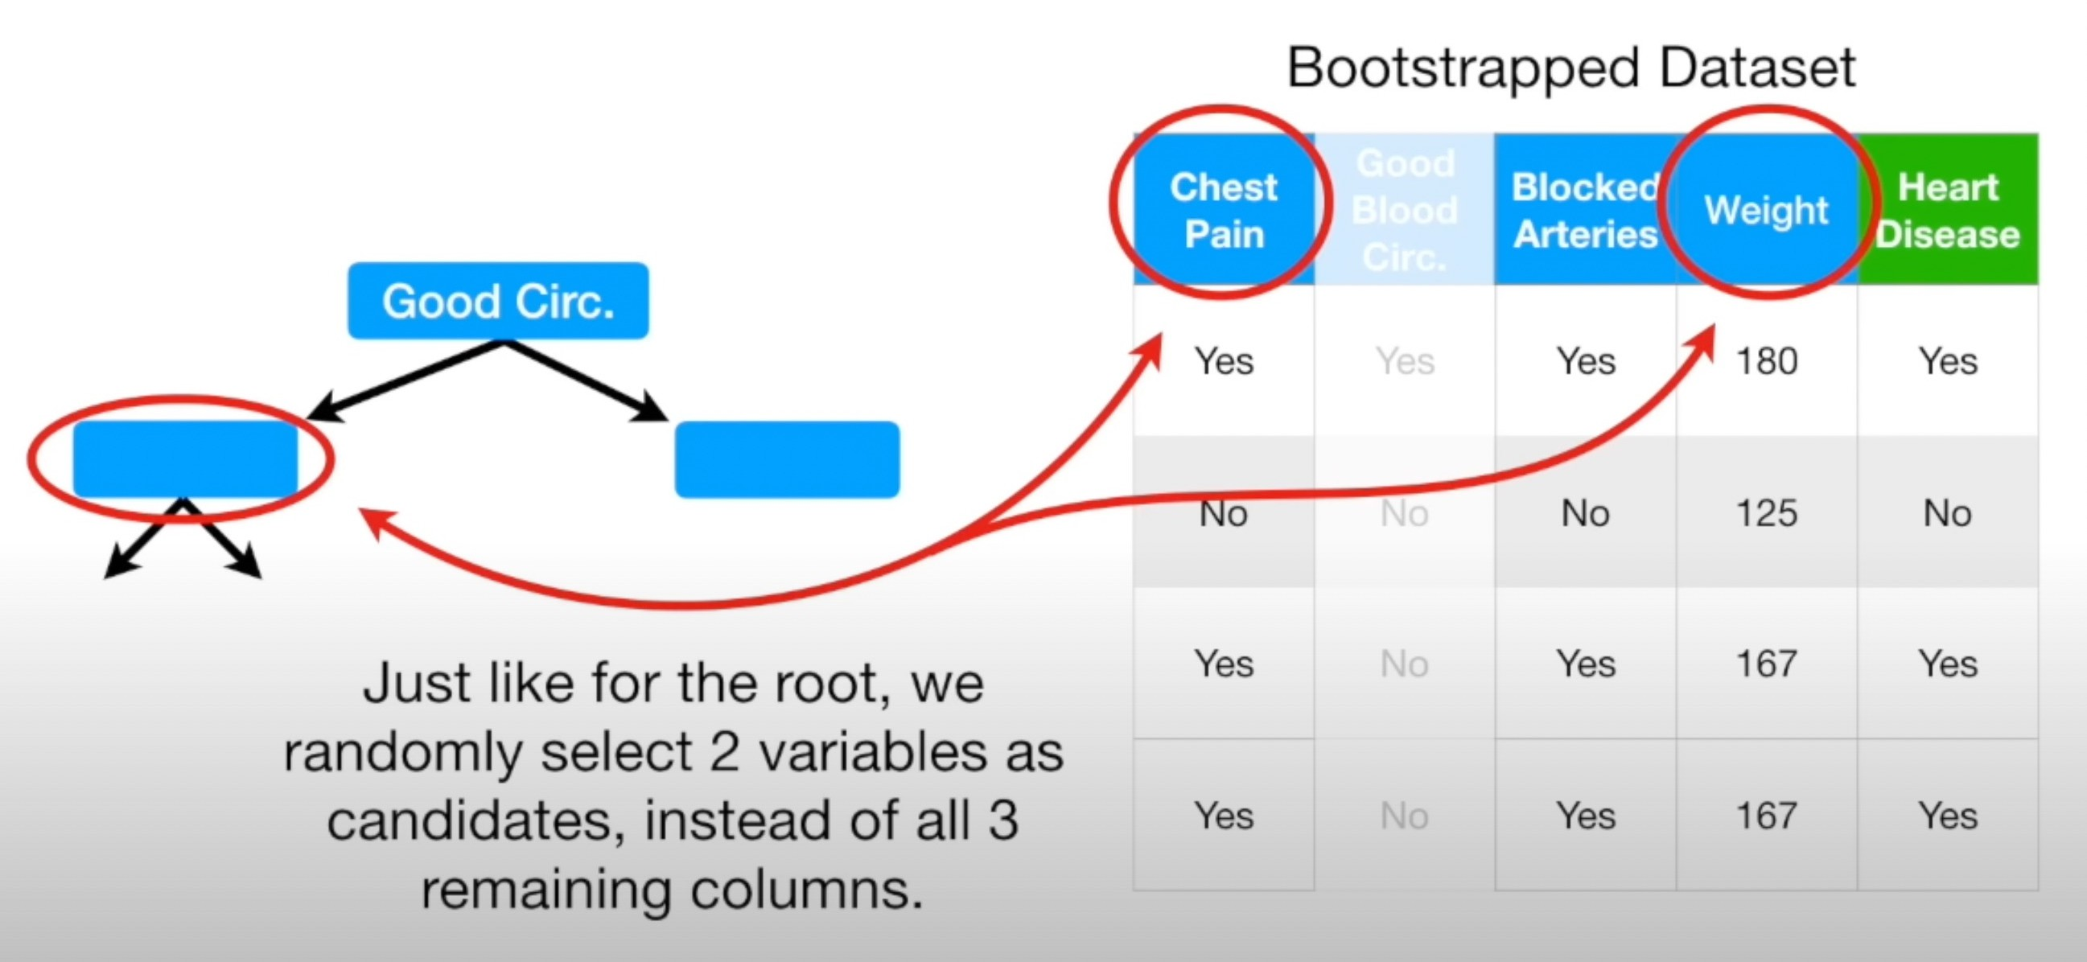

Slide 14
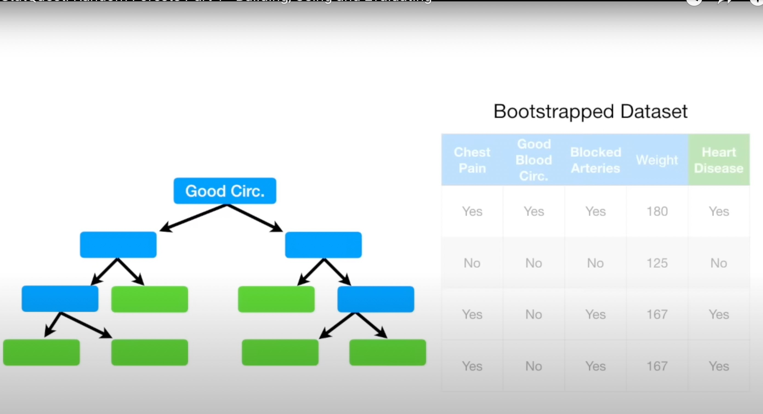

Slide 15
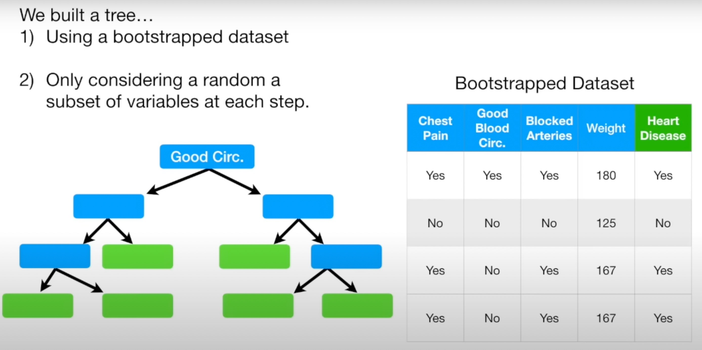

Slide 16
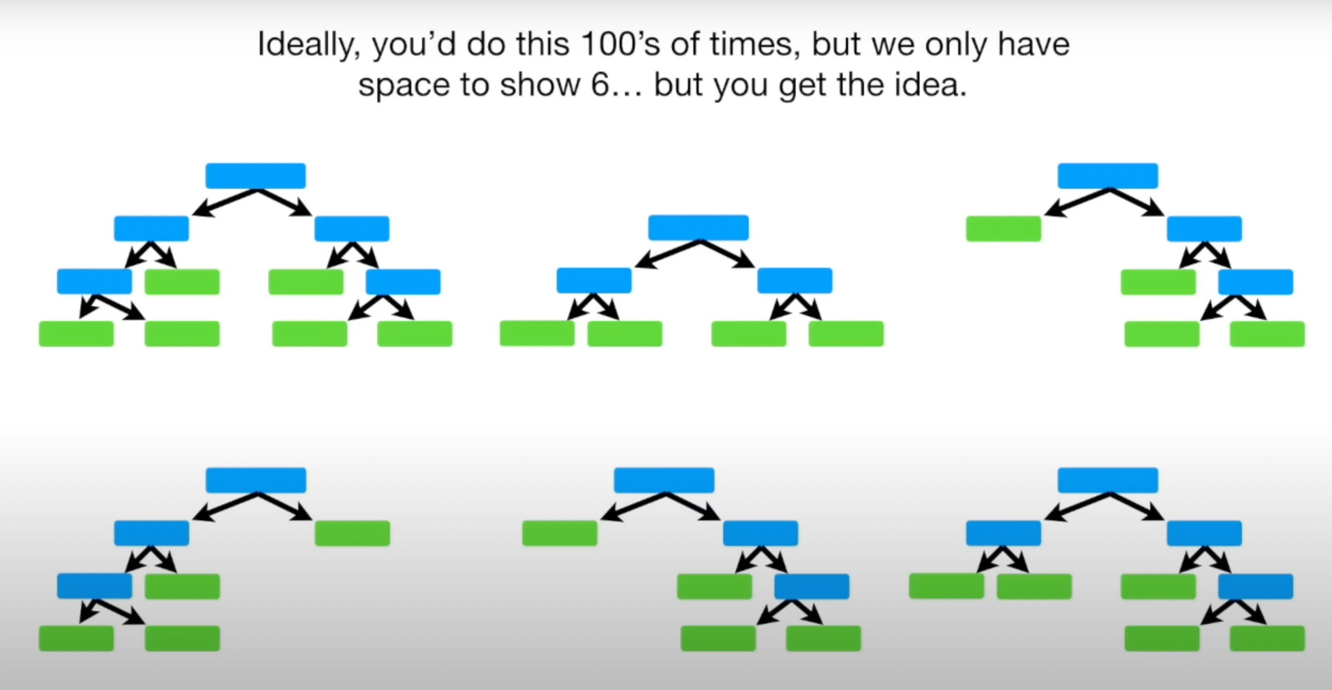

Slide 17
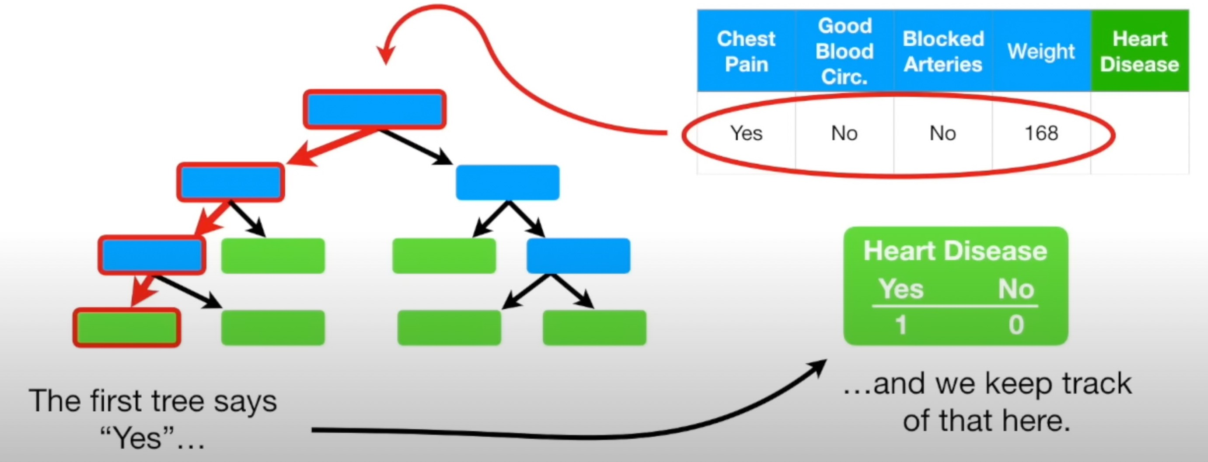

Slide 18
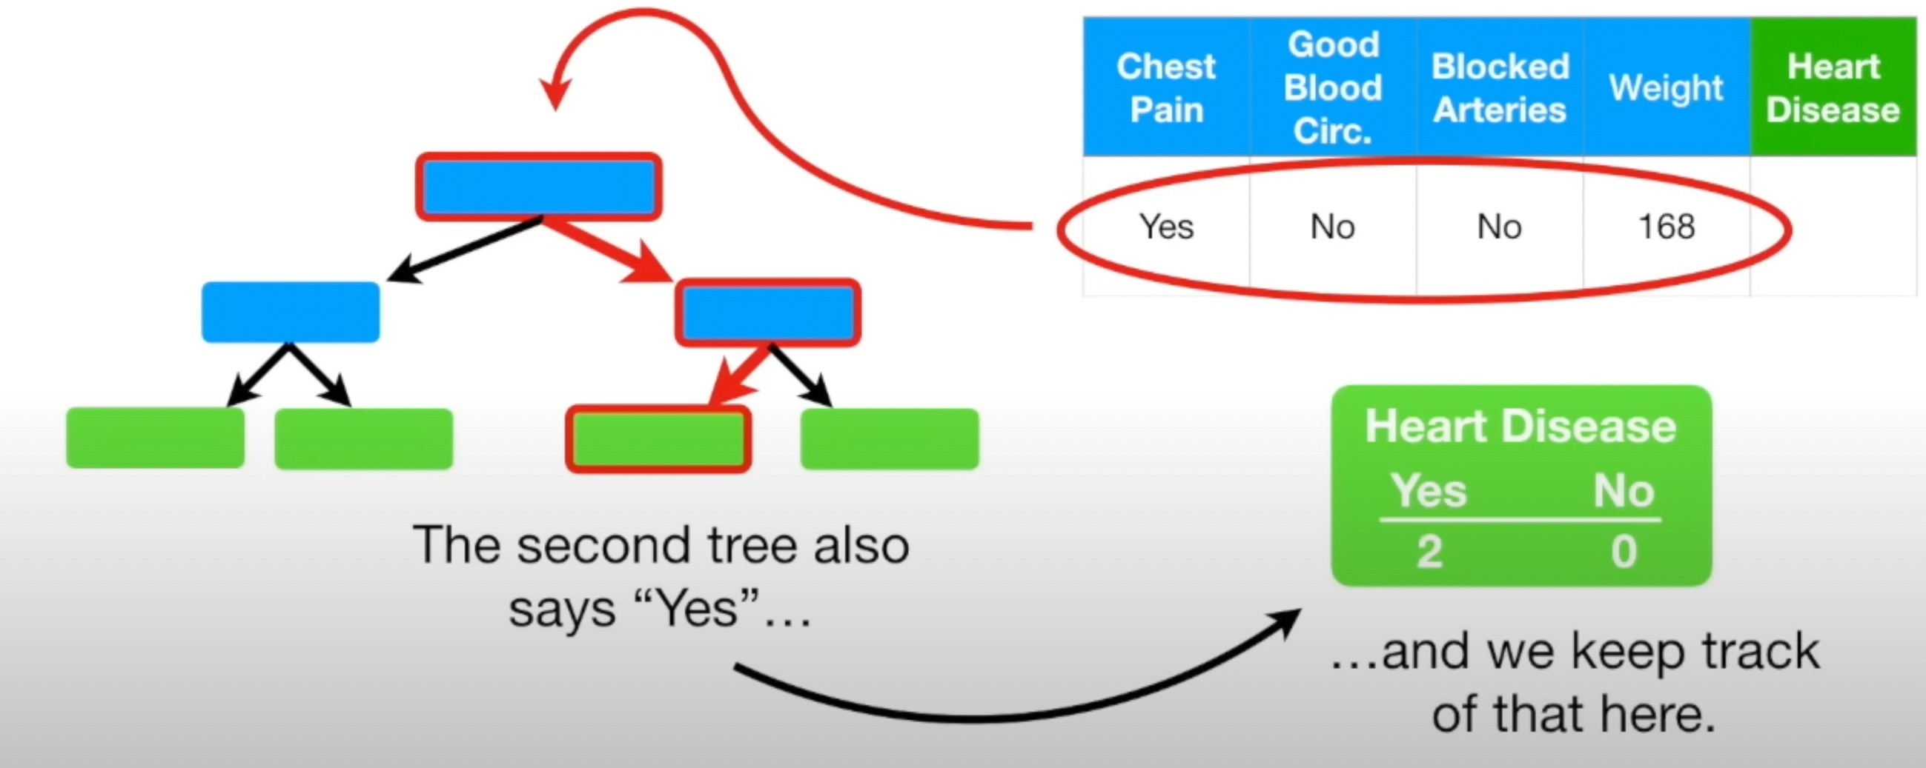

Slide 19
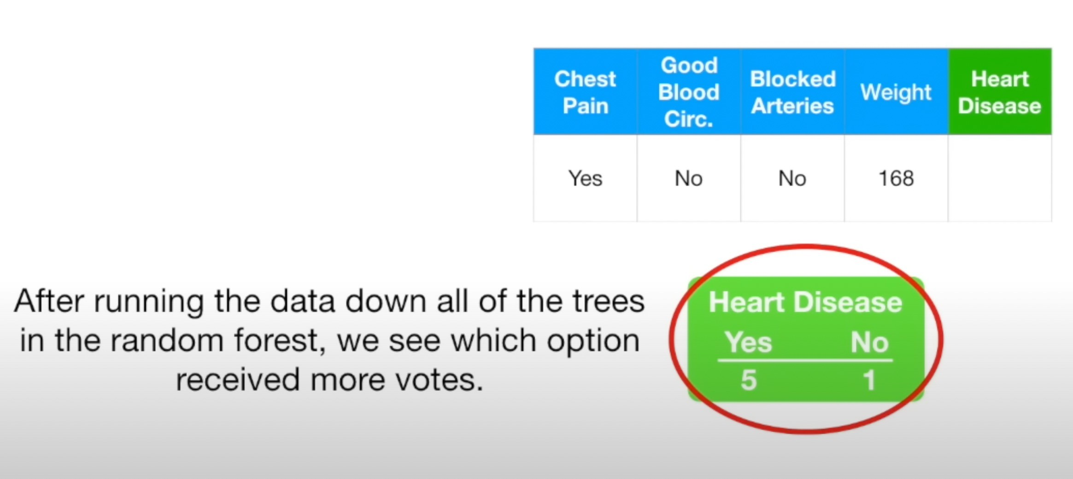

Slide 20
Bagging !!!!
Bootstrapping the data plus using the aggregate to make decision is called BAGGING

Slide 21
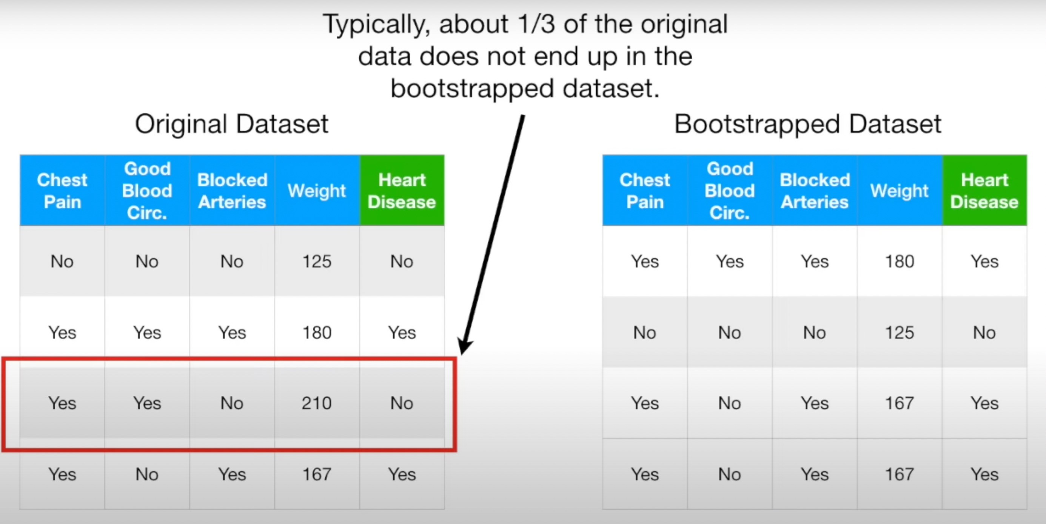
How to we do if its GOOD?
This is called out of Bag Data Set. We run it through and see if it correctly classifies the sample as “no” . We run this Out of Bag sample through all the other trees that were built wthout it …

Slide 22
Out-of-Bag Error
Ultimately, we can measure how accurate our random forest is by proportion of Out-of-Bag Samples that were correctly classified by the Random Forest.
The proportaion of Out-of-Bag samples that were incoreectly classified is the Out-of-Bag Error”

Slide 23
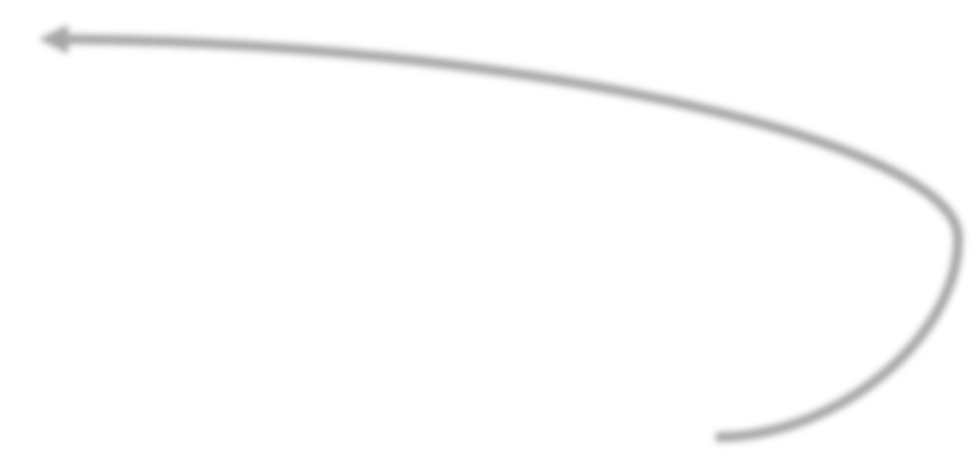
Steps Involved !!!!!
Build a Random Forest
Use a Random Forest
Estimate the accuracy of a Random Forest
Typically, we start by using the square root of the variables and then a few settings above and below that

Slide 24
Random Forest Classifier
Consider the following dataset.
Side Note: How did we know this threshold?
𝑥₀ ≤ 4.3
ID | 𝒙_{𝟎} | 𝒙_{𝟏} | 𝒙_{𝟐} | 𝒙_{𝟑} | 𝒙_{𝟒} | 𝒚
0 | 4.3 | 4.9 | 4.1 | 4.7 | 5.5 | 0
1 | 3.9 | 6.1 | 5.9 | 5.5 | 5.9 | 0
2 | 2.7 | 4.8 | 4.1 | 5.0 | 5.6 | 0
3 | 6.6 | 4.4 | 4.5 | 3.9 | 5.9 | 1
4 | 6.5 | 2.9 | 4.7 | 4.6 | 6.1 | 1
5 | 2.7 | 6.7 | 4.2 | 5.3 | 4.8 | 1
No
Yes
𝒚 = 𝟏
𝑥₁ ≤ 6.1
Yes
No
𝒚 = 𝟎
𝒚 = 𝟏
Idea: Build many more trees from the data…
A Slight change/error in the input data can cause a very different decision tree, hence, affecting its generalizability.
2
4

Slide 25
Random Forest Classifier
Consider the following dataset.
 |  | Step 1: Create more than one datasets by picking up instances at random
ID | 𝒙_{𝟎} | 𝒙_{𝟏} | 𝒙_{𝟐} | 𝒙_{𝟑} | 𝒙_{𝟒} | 𝒚 |  | ID |  | ID |  | ID |  | ID
0 | 4.3 | 4.9 | 4.1 | 4.7 | 5.5 | 0 |  | 2 |  | 2 |  | 4 |  | 3
1 | 3.9 | 6.1 | 5.9 | 5.5 | 5.9 | 0 |  | 0 |  | 1 |  | 1 |  | 3
2 | 2.7 | 4.8 | 4.1 | 5.0 | 5.6 | 0 |  | 2 |  | 3 |  | 3 |  | 2
3 | 6.6 | 4.4 | 4.5 | 3.9 | 5.9 | 1 |  | 4 |  | 1 |  | 0 |  | 5
4 | 6.5 | 2.9 | 4.7 | 4.6 | 6.1 | 1 |  | 5 |  | 4 |  | 0 |  | 1
5 | 2.7 | 6.7 | 4.2 | 5.3 | 4.8 | 1 |  | 5 |  | 4 |  | 2 |  | 2
Bootstrapped Datasets
Records are being repeated in a dataset because we are using random sampling with replacement. In each dataset, there should be equal number of records.
2
5

Slide 26
Random Forest Classifier
Consider the following dataset.
Step 2: Select a subset of features randomly for every dataset
ID | 𝒙_{𝟎} | 𝒙_{𝟏} | 𝒙_{𝟐} | 𝒙_{𝟑} | 𝒙_{𝟒} | 𝒚
0 | 4.3 | 4.9 | 4.1 | 4.7 | 5.5 | 0
1 | 3.9 | 6.1 | 5.9 | 5.5 | 5.9 | 0
2 | 2.7 | 4.8 | 4.1 | 5.0 | 5.6 | 0
3 | 6.6 | 4.4 | 4.5 | 3.9 | 5.9 | 1
4 | 6.5 | 2.9 | 4.7 | 4.6 | 6.1 | 1
5 | 2.7 | 6.7 | 4.2 | 5.3 | 4.8 | 1
 | ID
 | 2
 | 0
 | 2
 | 4
 | 5
 | 5
𝒙_{𝟎}, 𝒙_{𝟏}
ID
2
1
3
1
4
4
𝒙_{𝟐}, 𝒙_{𝟑}
ID
4
1
3
0
0
2
𝒙_{𝟐}, 𝒙_{𝟒}
ID
3
3
2
5
1
2
𝒙_{𝟏}, 𝒙_{𝟑}
2
6

Slide 27
Random Forest Classifier
Consider the following dataset.
Step 2: Select a subset of features randomly for every dataset
ID | 𝒙_{𝟎} | 𝒙_{𝟏} | 𝒙_{𝟐} | 𝒙_{𝟑} | 𝒙_{𝟒} | 𝒚
0 | 4.3 | 4.9 | 4.1 | 4.7 | 5.5 | 0
1 | 3.9 | 6.1 | 5.9 | 5.5 | 5.9 | 0
2 | 2.7 | 4.8 | 4.1 | 5.0 | 5.6 | 0
3 | 6.6 | 4.4 | 4.5 | 3.9 | 5.9 | 1
4 | 6.5 | 2.9 | 4.7 | 4.6 | 6.1 | 1
5 | 2.7 | 6.7 | 4.2 | 5.3 | 4.8 | 1
ID | 𝒙_{𝟎} | 𝒙_{𝟏} | 𝒚
2 | 2.7 | 4.8 | 0
0 | 4.3 | 4.9 | 0
2 | 2.7 | 4.8 | 0
4 | 6.5 | 2.9 | 1
5 | 2.7 | 6.7 | 1
5 | 2.7 | 6.7 | 1
ID | 𝒙_{𝟐} | 𝒙_{𝟑} | 𝒚
2 | 4.1 | 5.0 | 0
1 | 5.9 | 5.5 | 0
3 | 4.5 | 3.9 | 1
1 | 5.9 | 5.5 | 0
4 | 4.7 | 4.6 | 1
4 | 4.7 | 4.6 | 1
ID | 𝒙_{𝟐} | 𝒙_{𝟒} | 𝒚
4 | 4.7 | 6.1 | 1
1 | 5.9 | 5.9 | 0
3 | 4.5 | 5.9 | 1
0 | 4.1 | 5.5 | 0
0 | 4.1 | 5.5 | 0
2 | 4.1 | 5.6 | 0
ID | 𝒙_{𝟏} | 𝒙_{𝟑} | 𝒚
3 | 4.4 | 3.9 | 1
3 | 4.4 | 3.9 | 1
2 | 4.8 | 5.0 | 0
5 | 6.7 | 5.3 | 1
1 | 6.1 | 5.5 | 0
2 | 4.8 | 5.0 | 0
2
7

Slide 28
Random Forest Classifier
Consider the following dataset.
Step 3: Build a tree for each bootstrapped dataset
ID | 𝒙_{𝟎} | 𝒙_{𝟏} | 𝒚
2 | 2.7 | 4.8 | 0
0 | 4.3 | 4.9 | 0
2 | 2.7 | 4.8 | 0
4 | 6.5 | 2.9 | 1
5 | 2.7 | 6.7 | 1
5 | 2.7 | 6.7 | 1
ID | 𝒙_{𝟐} | 𝒙_{𝟑} | 𝒚
2 | 4.1 | 5.0 | 0
1 | 5.9 | 5.5 | 0
3 | 4.5 | 3.9 | 1
1 | 5.9 | 5.5 | 0
4 | 4.7 | 4.6 | 1
4 | 4.7 | 4.6 | 1
ID | 𝒙_{𝟐} | 𝒙_{𝟒} | 𝒚
4 | 4.7 | 6.1 | 1
1 | 5.9 | 5.9 | 0
3 | 4.5 | 5.9 | 1
0 | 4.1 | 5.5 | 0
0 | 4.1 | 5.5 | 0
2 | 4.1 | 5.6 | 0
ID | 𝒙_{𝟏} | 𝒙_{𝟑} | 𝒚
3 | 4.4 | 3.9 | 1
3 | 4.4 | 3.9 | 1
2 | 4.8 | 5.0 | 0
5 | 6.7 | 5.3 | 1
1 | 6.1 | 5.5 | 0
2 | 4.8 | 5.0 | 0
𝒙_{𝟏} ≤ 𝟒. 𝟗
𝒙_{𝟑} ≤ 𝟒. 𝟔
𝒙_{𝟐} ≤ 𝟒. 𝟏
𝒙_{𝟏} ≤ 𝟒. 𝟒
Yes No
Yes No
Yes No
Yes No
𝒙_{𝟎} ≤ 𝟒. 𝟑
𝒚 = 𝟏
𝒚 = 𝟏
𝒚 = 𝟎
𝒚 = 𝟎
𝒙_{𝟐} ≤ 𝟒. 𝟕
𝒚 = 𝟏
𝒙_{𝟏} ≤ 𝟔. 𝟏
Yes No
Yes No
Yes No
𝒚 = 𝟎
𝒚 = 𝟏
𝒚 = 𝟏
𝒚 = 𝟎
𝒚 = 𝟎
𝒚 = 𝟏
Note: A feature can repeat in a tree if it still has distinct values left (for that path).
2
8

Slide 29
Random Forest Classifier
Consider following test record
Step 4: Use all trees for predictions…
𝒙_{𝟏} ≤ 𝟒. 𝟗
𝒙_{𝟑} ≤ 𝟒. 𝟔
𝒙_{𝟐} ≤ 𝟒. 𝟏
𝒙_{𝟏} ≤ 𝟒. 𝟒
Yes No
Yes No
Yes No
Yes No
𝒙_{𝟎} ≤ 𝟒. 𝟑
𝒚 = 𝟏
𝒚 = 𝟏
𝒚 = 𝟎
𝒚 = 𝟎
𝒙_{𝟐} ≤ 𝟒. 𝟕
𝒚 = 𝟏
𝒙_{𝟏} ≤ 𝟔. 𝟏
Yes No
Yes No
Yes No
𝒚 = 𝟎
𝒚 = 𝟏
𝒚 = 𝟏
𝒚 = 𝟎
𝒚 = 𝟎
𝒚 = 𝟏
𝒚 = 𝟏
𝒚 = 𝟎
𝒚 = 𝟏
𝒚 = 𝟏
𝒙_{𝟎} | 𝒙_{𝟏} | 𝒙_{𝟐} | 𝒙_{𝟑} | 𝒙_{𝟒} | 𝒚
2.8 | 6.2 | 4.3 | 5.3 | 5.5 | ?
Step 5: Consider majority vote to label the test record (Aggregating)
Bootstrapping + Aggregating is called “Bagging”

Slide 30
Random Forest Classifier
Why a forest?
Because there are multiple trees, making one classifier as a whole
Why Random?
Because of bootstrapping (random sampling) and random feature selection
Why do Bootstrapping and feature selection?
To ensure that each tree is different from the other in the forest
Helps to reduce correlation amongst the trees
To ensure that few trees train on less important features, while few trained on best features. At the end, the trees trained on less important features will give bad predictions; thus, their effect will smooth out when taking majority vote.
30

Slide 31
Random Forest Classifier
How many features should be selected for each tree?
We used 2 features
Research suggests that using square root of total number of features, or log of the total number of features work well
31

Slide 32
Book Reading
Murphy – Chapter 1, Chapter 14
Tom Mitchel (TM) – Chapter 3
32

